Slide 1
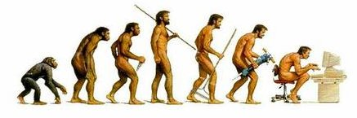
Renaming H.Sapiens
Julian Cribb, FTSE
ANU Emeritus Faculty
October 24, 2012

Slide 2
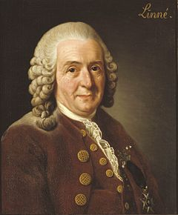
Linnaeus
Carle von Linné (Linnaeus) 1707-78 ‘Father of Taxonomy’
Systema Naturae 1735 proposes bionomial classification system
Names H. sapiens, 1758, in ‘anthropomorpha’

Slide 3
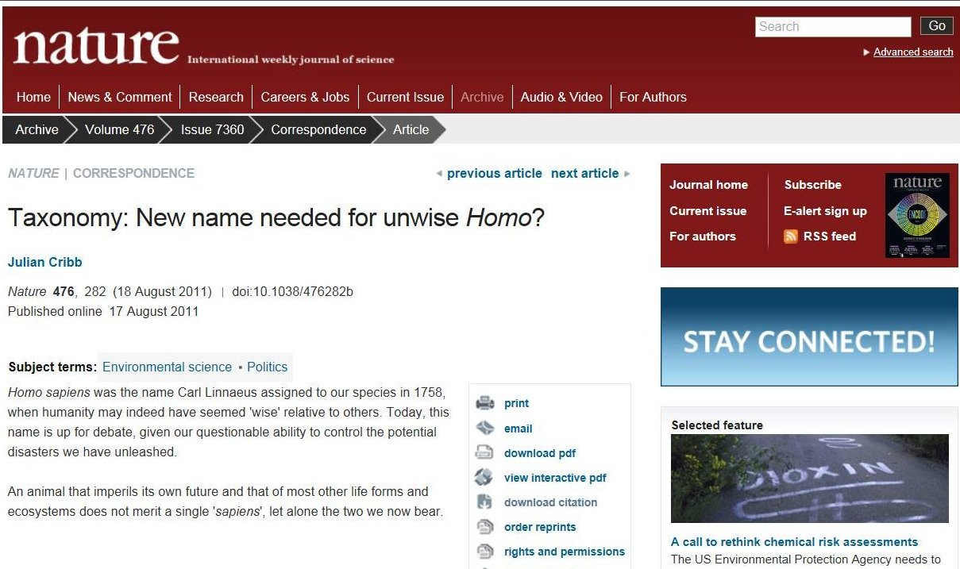
A new name?

Slide 4
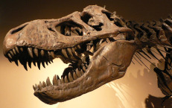
Extinctions
Past extinctions:
  Ordovician – 440 my BP – 25% of families lost
  Devonian, 370 my – 19% lost
  Permian – 245my – 54% of families lost (96% 0f marine species)
  Triassic – 210my – 23% lost
  KT – 65my – 17% lost
Anthropocene extinction:
  >30,000 species/year lost (Wilson)
  Hunting (megafauna); farming ; Earth system modification.
  First biotically-caused extinction (Eldredge).

Slide 5
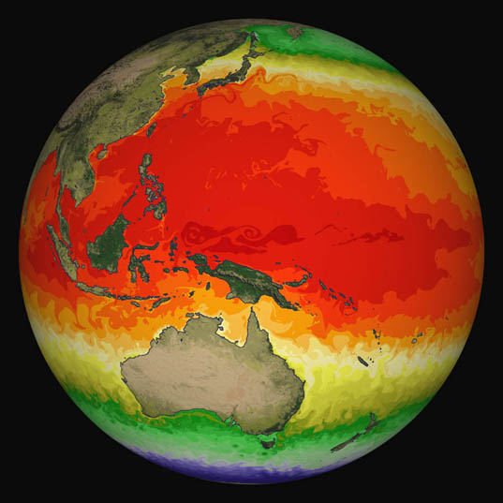
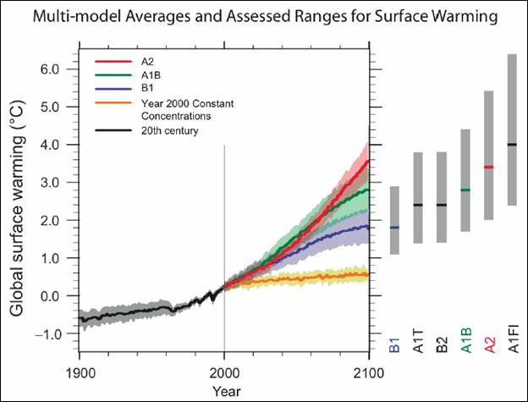
Global climate +4-5º
Global carbon emissions now tracking A1F1 (high) scenario
2 degrees of warming by 2050 locked in
4-5 degrees of warming by 2100 probable
‘runaway’ warming of 10-400 degrees possible
Source: IPCC
Notes:
All this is happening at a time when the climate which gave birth to agriculture – the Holocene – is changing forever.
An unstable warming climate will make the growing of food by traditional means extremely difficult, costly and in many cases, impossible by the second half of this century.

Slide 6

Chemical assault
83,000 man-made chemicals (USEPA)
550 have known risks
New, untested chemicals released constantly, eg 1000+ nanosubstances
Earthwide contamination via water, air, soil and life
Extensive contamination of mother’s milk, food
>287 industrial chemicals (inc. 180 carcinogens) found in US newborns

Slide 7
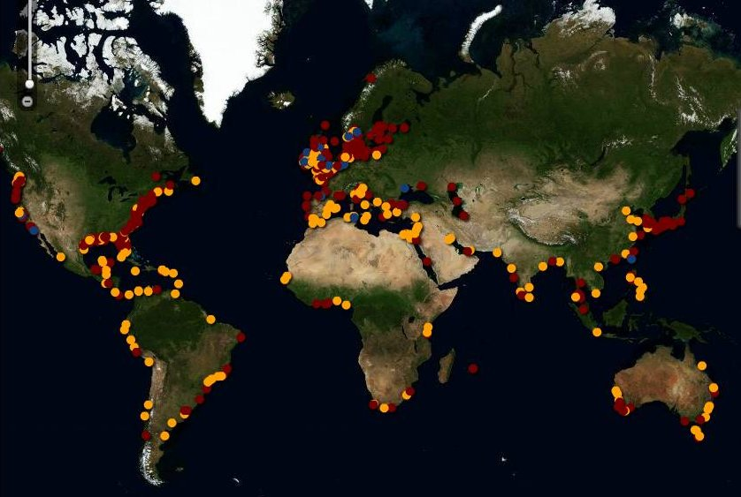
Dead zones
476 ‘dead zones’ worldwide, driven by NPK discharge into oceans and estuaries

Slide 8
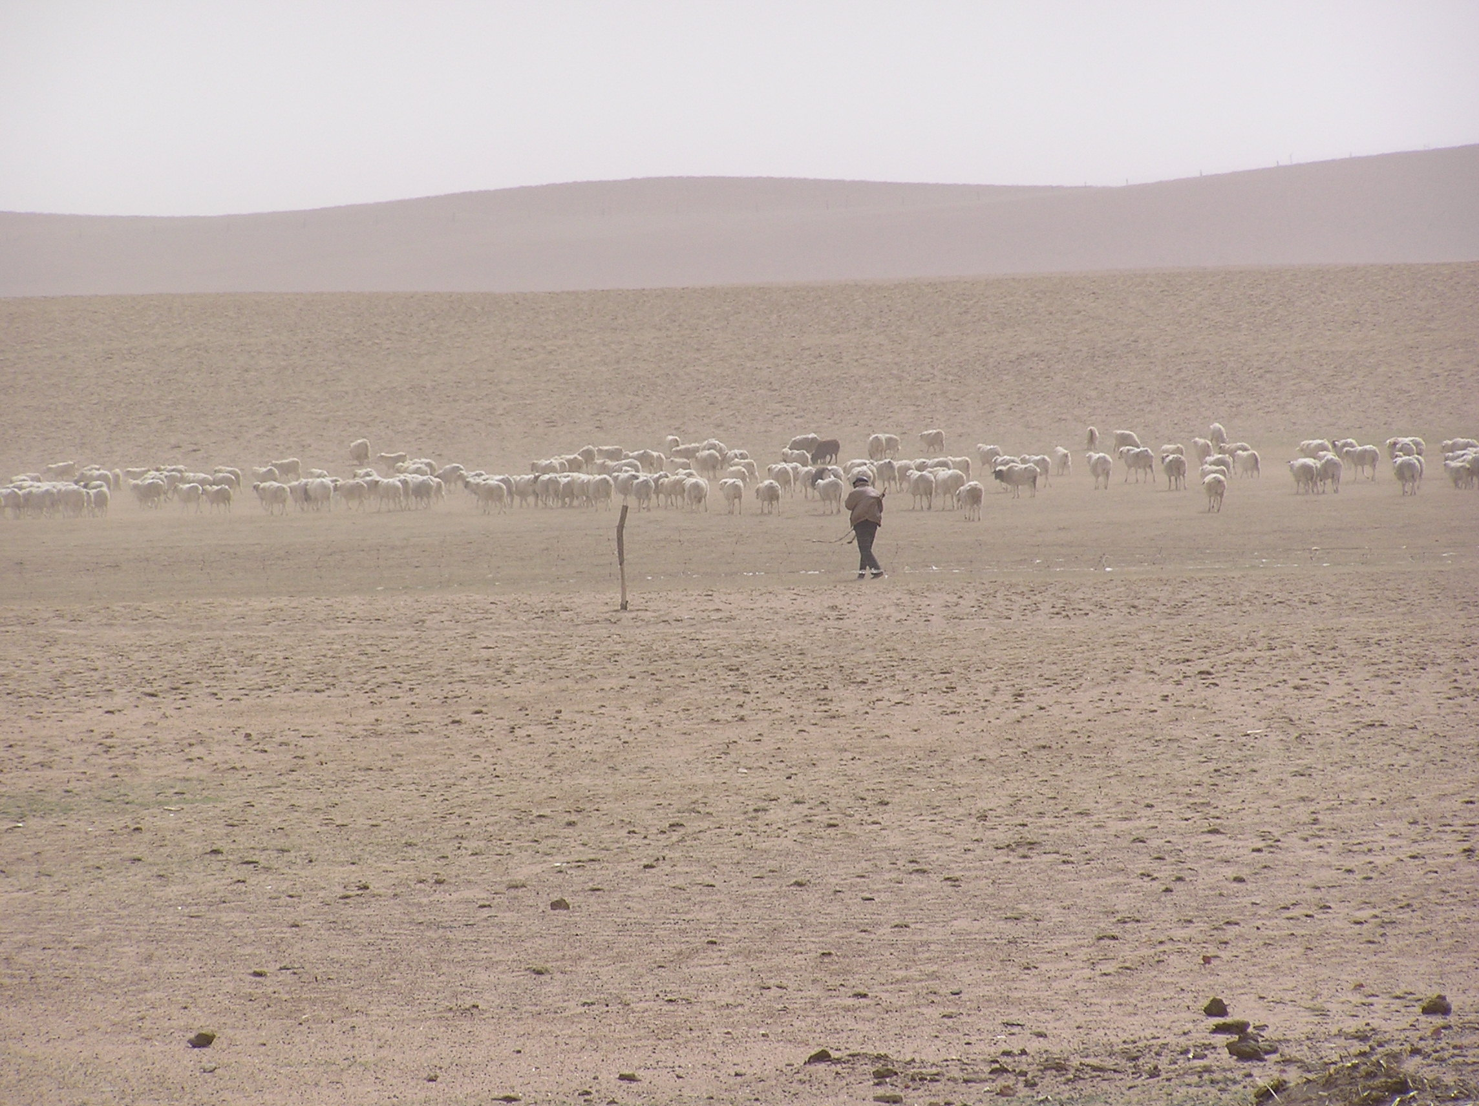
Our vanishing land
“The Earth is losing topsoil at a rate of 75 to 100 GT. per year. If soil loss continues at present rates, it is estimated that there is only another 48 years of topsoil left.”
- Marler & Wallin, Nutrition Security Institute, USA, 2006
Notes:
The world is losing 75-100 gigatonnes of topsoil and about 1 per cent of its farm land every year. At this rate we will run out of soil within 50-70 years.
Megacities and their playgrounds will double in size to gobble up an area as large as China and the US combined.

Slide 9
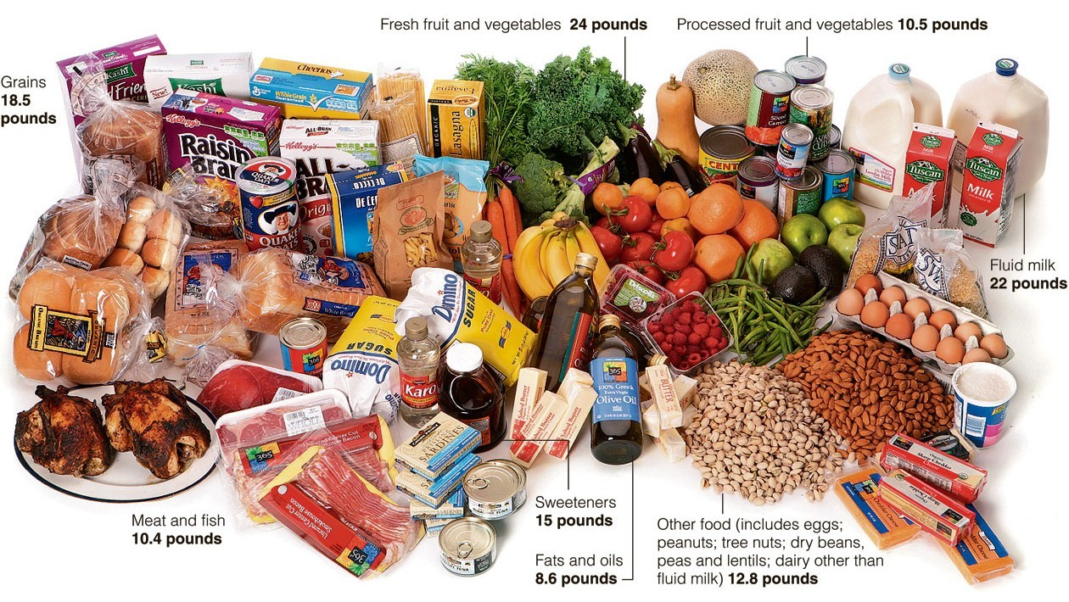
Food waste
Source: USDA, NYT

Slide 10
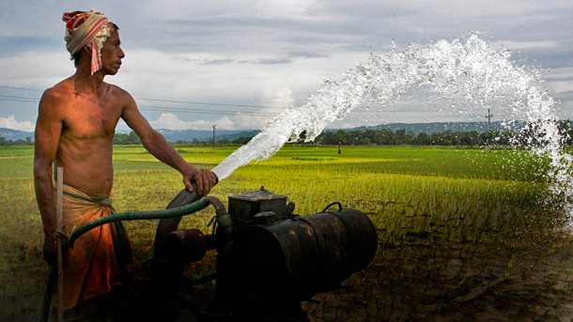
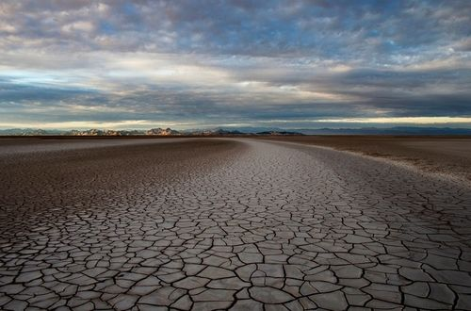
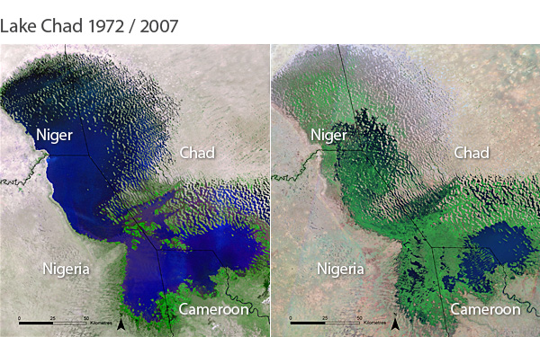
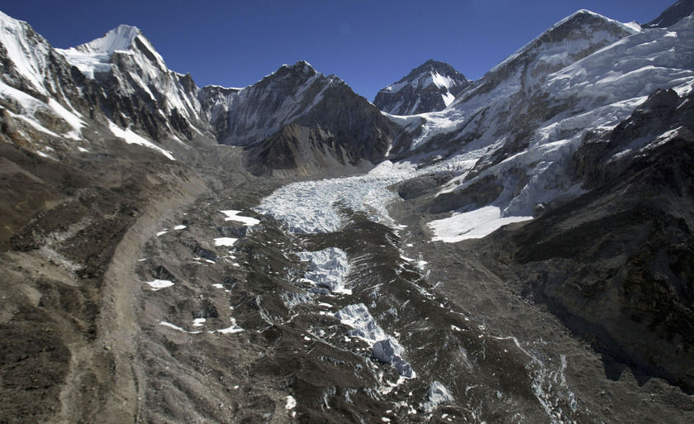
Peak water
“Current estimates indicate we will not have enough water to feed ourselves in 25 years time...”
– Colin Chartres, IWMI
Groundwater mining
Disappearing rivers
Vanishing lakes
Shrinking glaciers
Notes:
In countries like China, India and the US, groundwater is seriously depleted.
And climate change is reducing rainfall over the great grain bowls, snowpack on high mountains, lakes, rivers and aquifers in dry lands.
This combination means world food production will face critical water scarcity as early as the 2030s.

Slide 11
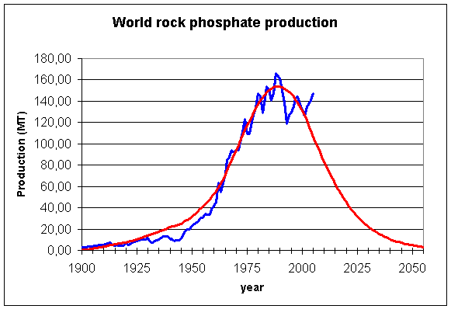
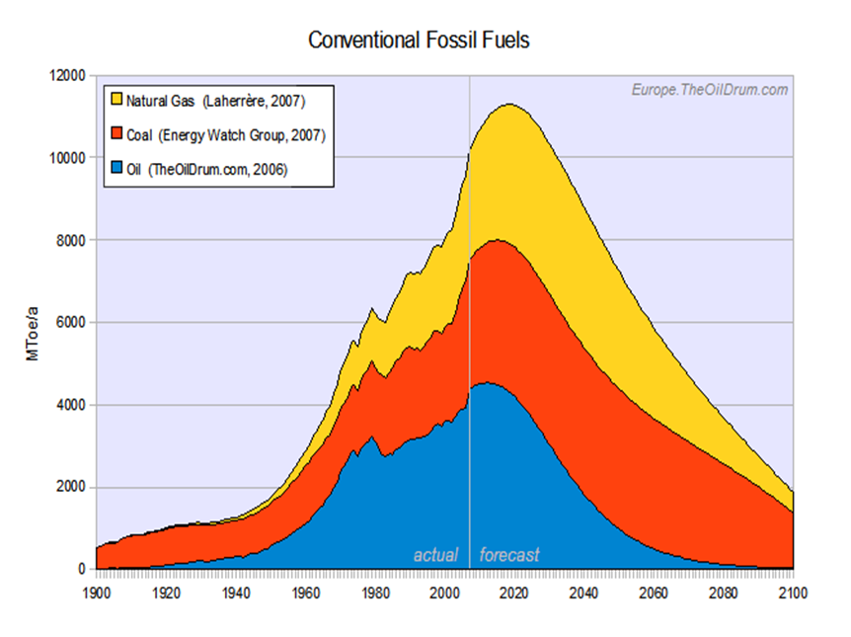
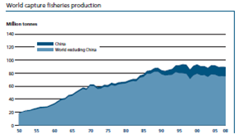
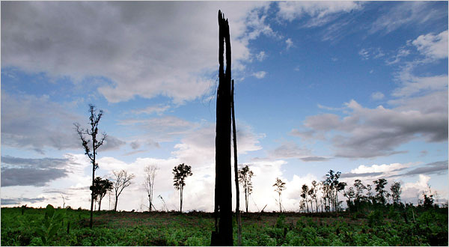
Peak resources
Peak oil 2006
Peak Fish 2004
Peak P 2030-40?
Forest loss: 6.4mha/yr

Slide 12
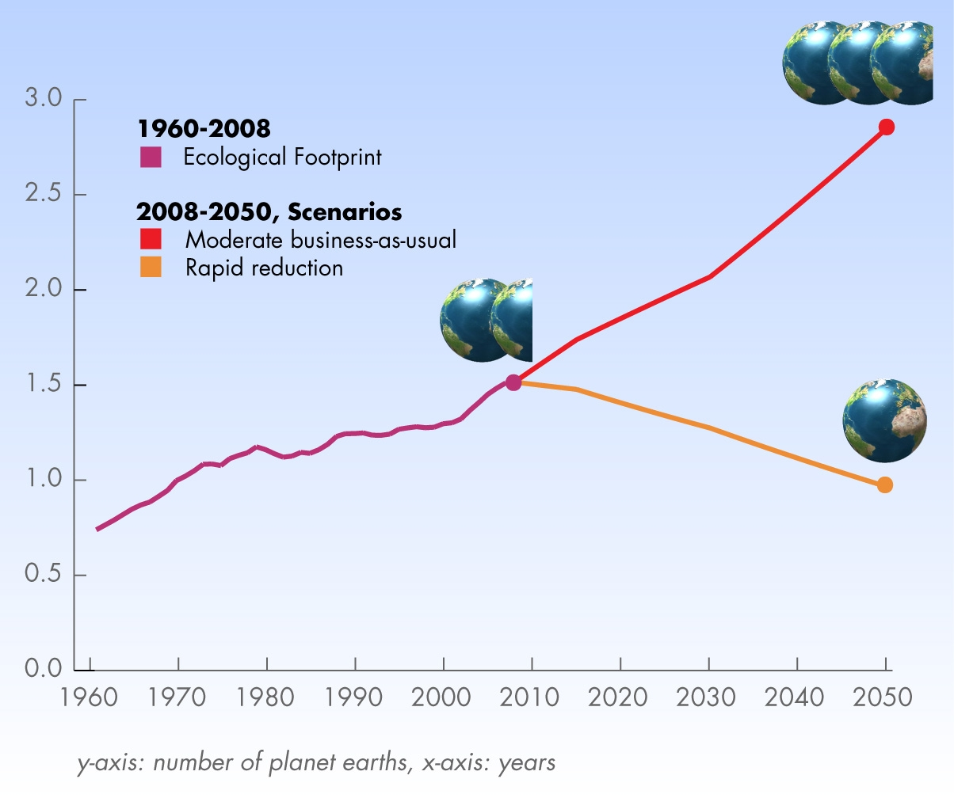
Our global footprint
Source: GFN 2012

Slide 13

Weapons
Not-so-
Annual global weapons spend: $1,600 billion (SIPRI)
Annual global spend on food R&D: $50bn (Pardey&al.)
20,000 nuclear warheads still exist
19 nations have nuclear capacity

Slide 14

Money
The main instrument of destruction is something which does not exist in the natural World, and now mostly consists of electrons.
Money is a figment of the human imagination.
If we run short of money we simply create more (=GFC).

Slide 15
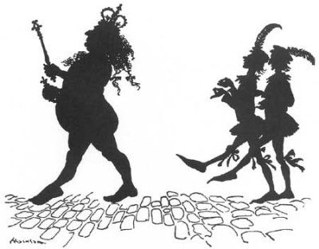
Was Hans Andersen right?
We are trading things that are real and finite – eg soil, water, natural resources, species and atmosphere – for something which is unreal and infinite: money.

Slide 16
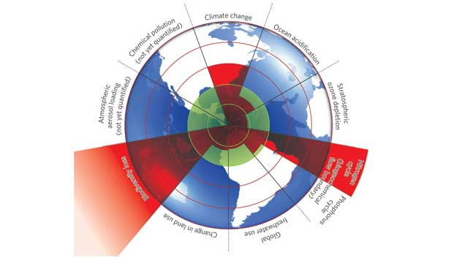
Boundaries we dare not cross...
Source: Rockstrom et al. 2009

Slide 17
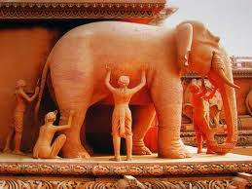
‘Wise, wise man’

Slide 18
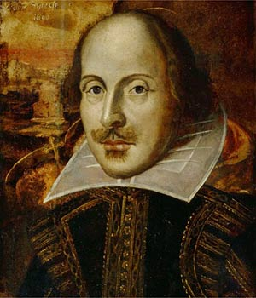
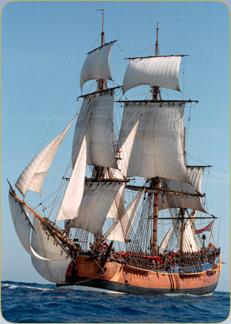
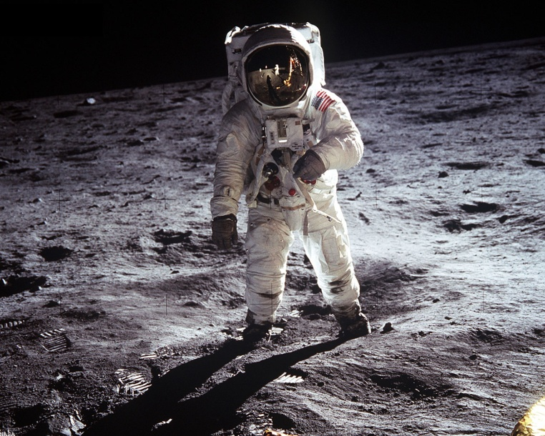
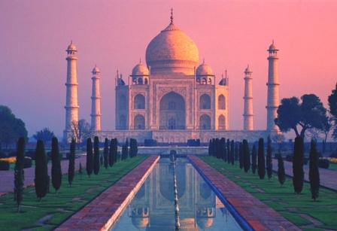
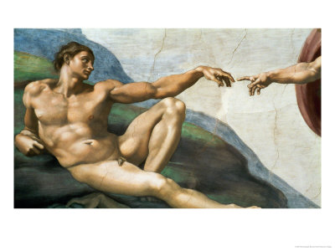
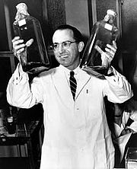
Achievements

Slide 19
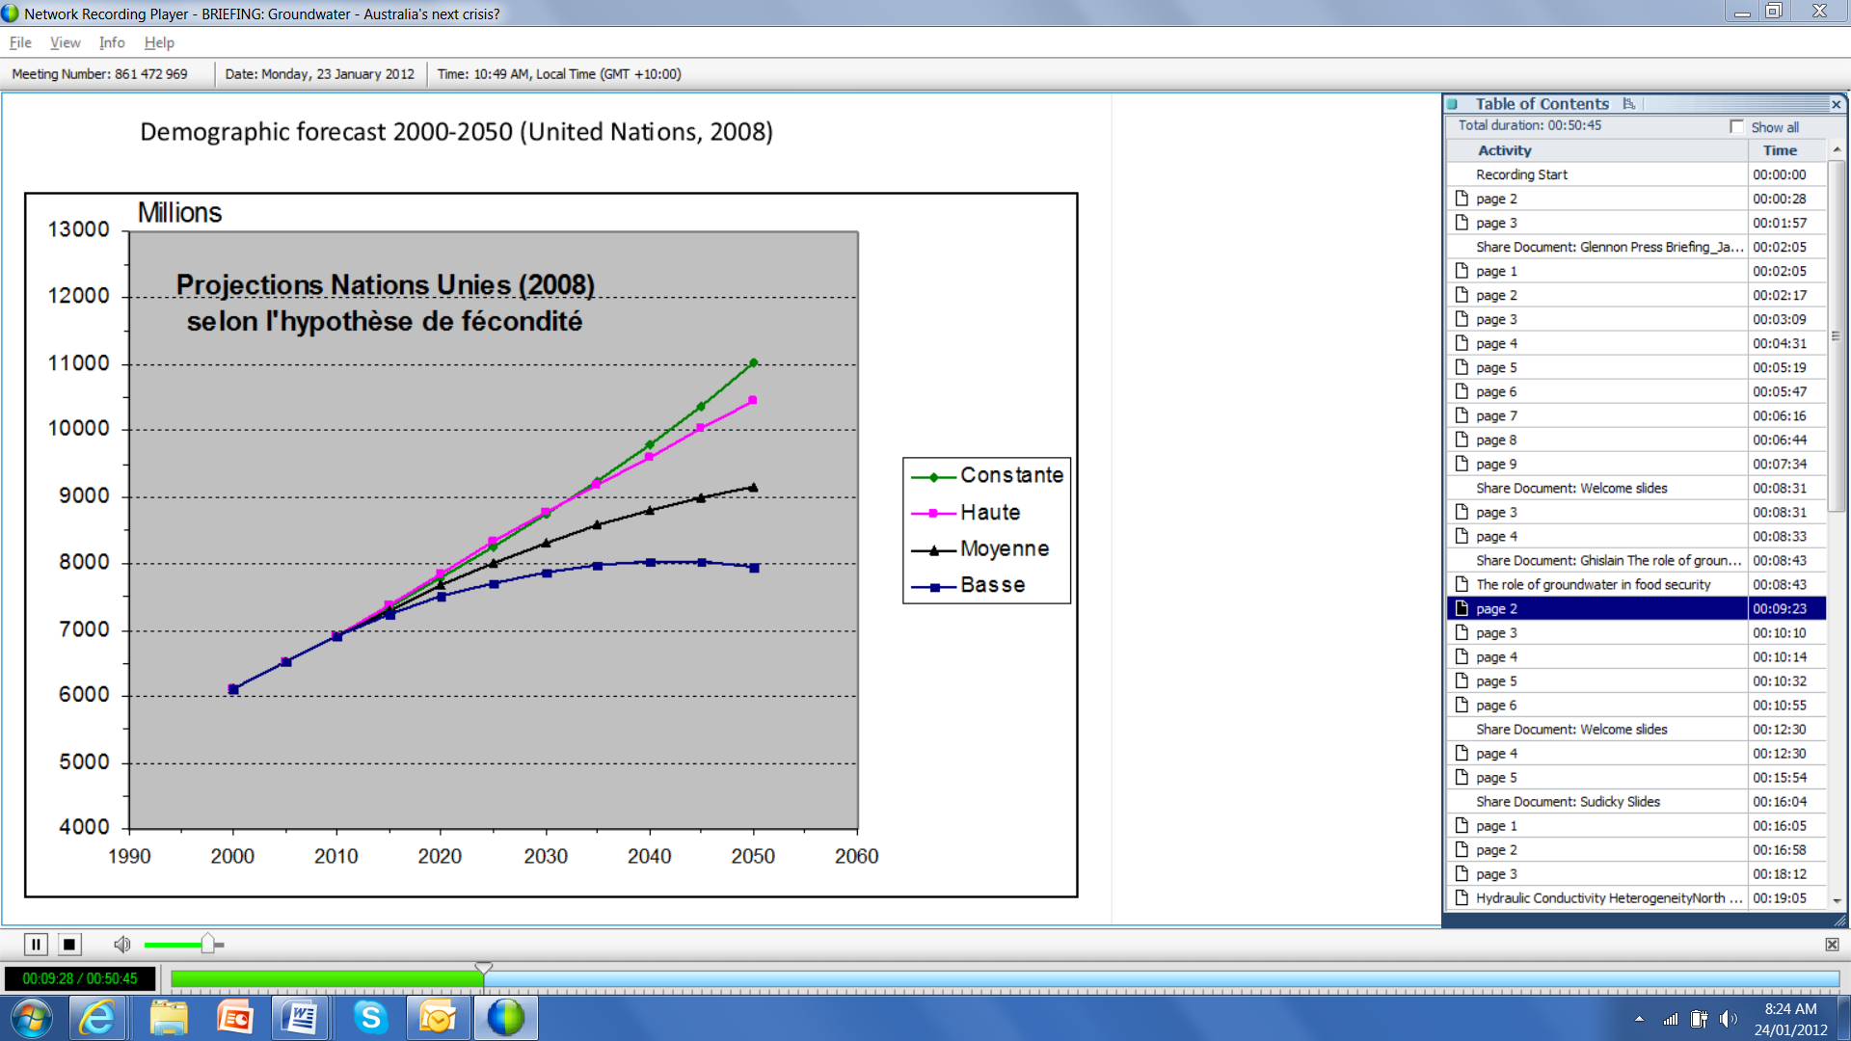
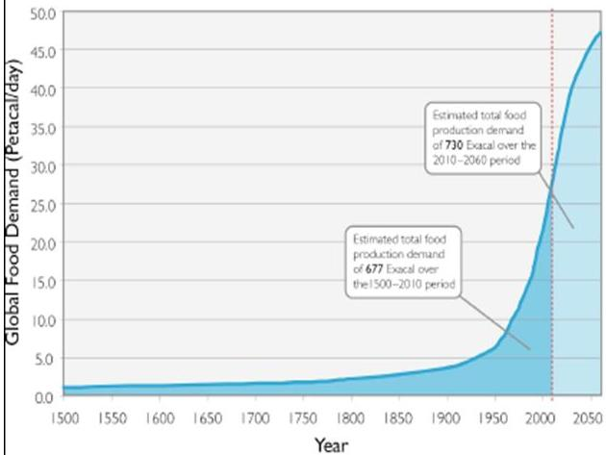
Population and food
Global food demand
to double
Notes:
We are facing the greatest challenge in human history – how to feed ten billion people sustainably for more than half a century.
Tonight there will be 216,000 more people to dinner than there were last night.
While its growth rate is slowing, the human population continues to expand. It is likely to reach 10 billion people in the 2060s as more babies are born and older people live longer.
In line with economic growth, consumers in China, India, Brazil and other advancing economies will demand more meat and high protein foods.
Together these factors will double global food demand by the 2060s – and all of that demand, directly or indirectly, must be satisfied by the growing and harvesting of plants.
By the 2060s we will need around 600 quadrillion calories every single day – all of it initially from plants.
My first point is that the central issue in the human destiny in the 21st century is whether we can achieve and sustain such a mighty harvest.

Slide 20
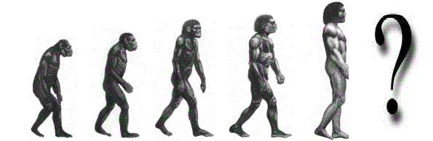
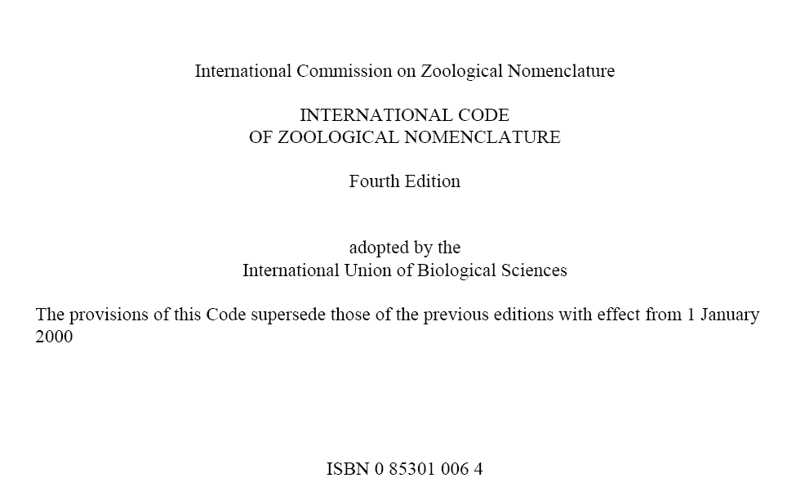
Taxonomy

Slide 21
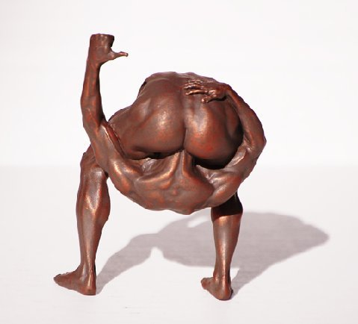
What should we call ourselves?
Pan daemonicus – the ‘demon chimp’
Homo profligans
Homo stultus
Homo struthiones (ostrich man)
Yahoo vulgaris (vulgar yahoo, after Swift)
Homo erectus dyfunctionalis
Homo drongo
Homo gluteus sapiens
http://goo.gl/J8Jv0
She’ll be right, mate!

